Slide 1

Representation and Analysis of Dynamical Systems
裴 昕
S-I-A-E
2015.9

Slide 2
Outline
Introduction
Generalities
A first introductive example
Dynamic system classification
Modeling and mathematical representations of models
State-space representation
Transfer function representation
Functional block-diagram representation
Conversion state-space ⇔ transfer function
Experimental model
Linear system analysis
Modal analysis - stability analysis
Time-domain analysis
Frequency-domain analysis
Discrete-time linear systems
Discrete-time state space representation
Z-transform of discrete-time signal - Shannon theorem
Discrete-time transfer function
Stability Analysis of Discrete-time linear systems
Controllability and observability
Examples
Definitions and criterions

Slide 3
Outline
Introduction
Generalities
A first introductive example
Dynamic system classification
Modeling and mathematical representations of models
Linear system analysis
Discrete-time linear systems
Controllability and observability

Slide 4
Outline
Introduction
Generalities
A first introductive example
Dynamic system classification
Modeling and mathematical representations of models
Linear system analysis
Discrete-time linear systems
Controllability and observability

Slide 5
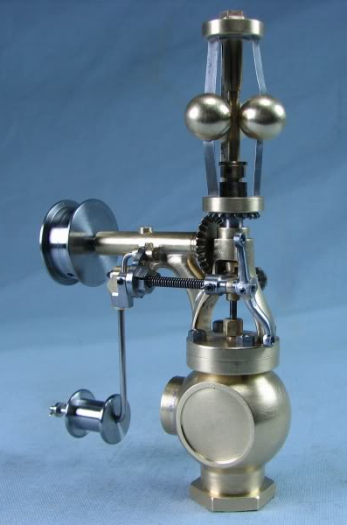


Generalities
Dynamical Systems
Control theory
Regulation systems using feedback control concept can be found:…
...in very old devices ...in human behaviors …in astronautics
(Watt regulator, 1769) (regulate body temperature, (airplane, satellite…)
driving a car…)

Slide 6
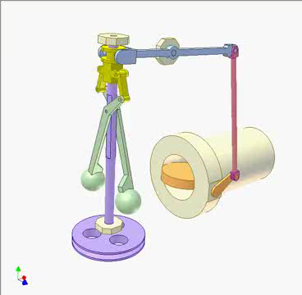
Generalities
Example:
Watt regulator ( Flyball governor )

Slide 7
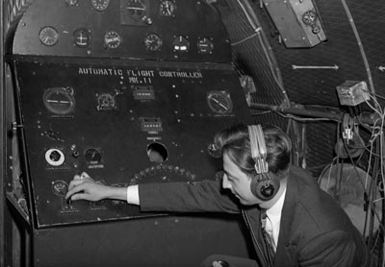
Generalities
Example:
Autopilot system
An early autopilot system in an Avro 19 plane, circa 1947.

Slide 8
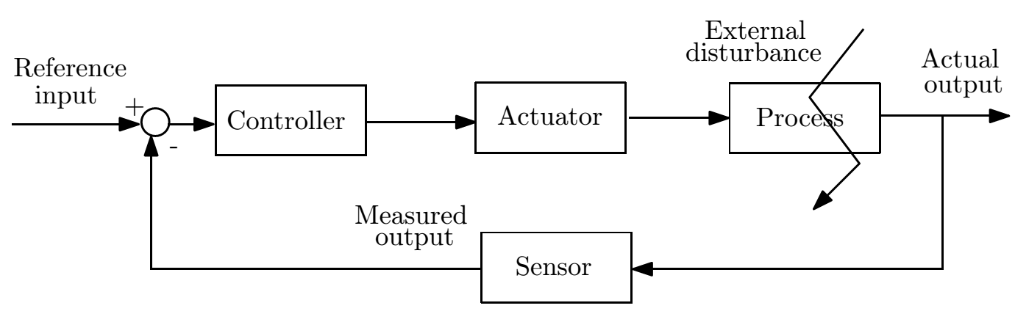
In each of theses examples, the basic idea consists:
to feedback a measurement (through a sensor) of the variable to be regulated,
to compare it with the reference input (desired output) to get the difference, or the closed-loop error,
to act on the process to reduce the closed-loop error through a controller and an actuator, in spite of external disturbances.
Block-diagram of closed-loop feedback system.
Each block assumes a cause-effect relationship for the corresponding component (input-output behavior).

Slide 9
When experimental tuning of the closed-loop behavior is not possible (eg.Spacecraft , ...), the first step consists to model each component of the loop. Then, Control theory proposes analysis tools to study the interaction between these components and design tools to built the servo-loop controller.
EE32 Objectives:
to model dynamic systems and to study mathematical representation of these models,
to analyze dynamic properties of open-loop (and also closed-loop) systems.
to design controllers to improve dynamic properties of the closed-loop systems according to specifications (in terms of stability, rapidness, disturbance rejection, reference input
tracking,...).

Slide 10
Outline
Introduction
Generalities
A first introductive example
Dynamic system classification
Modeling and mathematical representations of models
Linear system analysis
Discrete-time linear systems
Controllability and observability

Slide 11
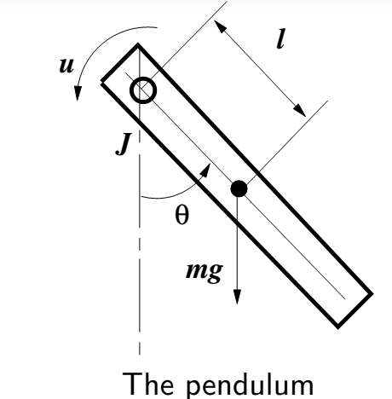
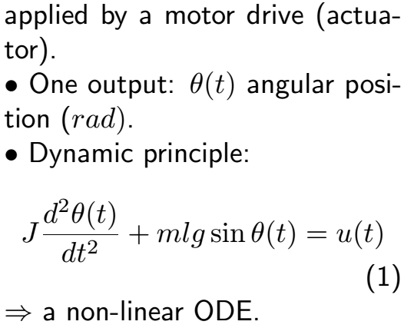
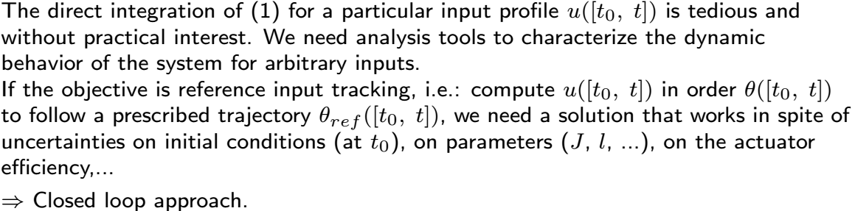
A first introductive example

Slide 12
Outline
Introduction
Generalities
A first introductive example
Dynamic system classification
Modeling and mathematical representations of models
Linear system analysis
Discrete-time linear systems
Controllability and observability

Slide 13
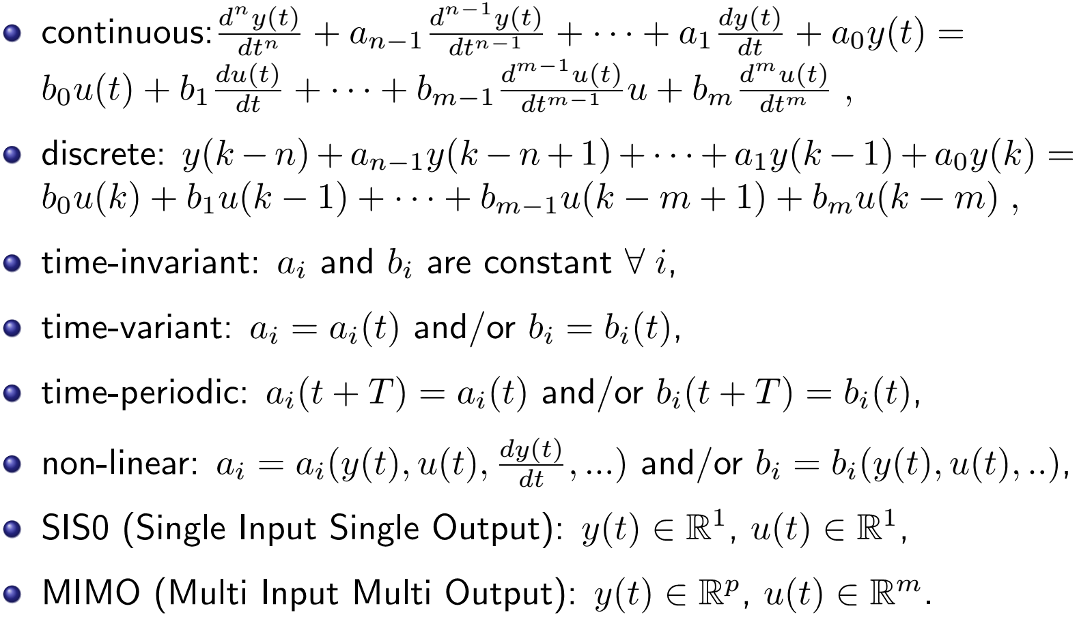
Dynamic system classification
A dynamic system between its input u and its output y can be:

Slide 14
Outline
Introduction
Modeling and mathematical representations of models
State-space representation
Transfer function representation
Functional block-diagram representation
Conversion state-space ⇔ transfer function
Experimental model
Linear system analysis
Discrete-time linear systems
Controllability and observability

Slide 15
Modeling and mathematical representations
of models
Knowledge-based model: to derive the system dynamic behavior from basic laws and principles of mechanical, electrical, ...engineering fields.
Various tools to describe the model:
State-space representation
Transfer function representation
Block-diagram representation
Experimental model: to identify the system input-output behavior from the output response to known typical input signals (test signals).

Slide 16
Outline
Introduction
Modeling and mathematical representations of models
State-space representation
Transfer function representation
Functional block-diagram representation
Conversion state-space ⇔ transfer function
Experimental model
Linear system analysis
Discrete-time linear systems
Controllability and observability

Slide 17
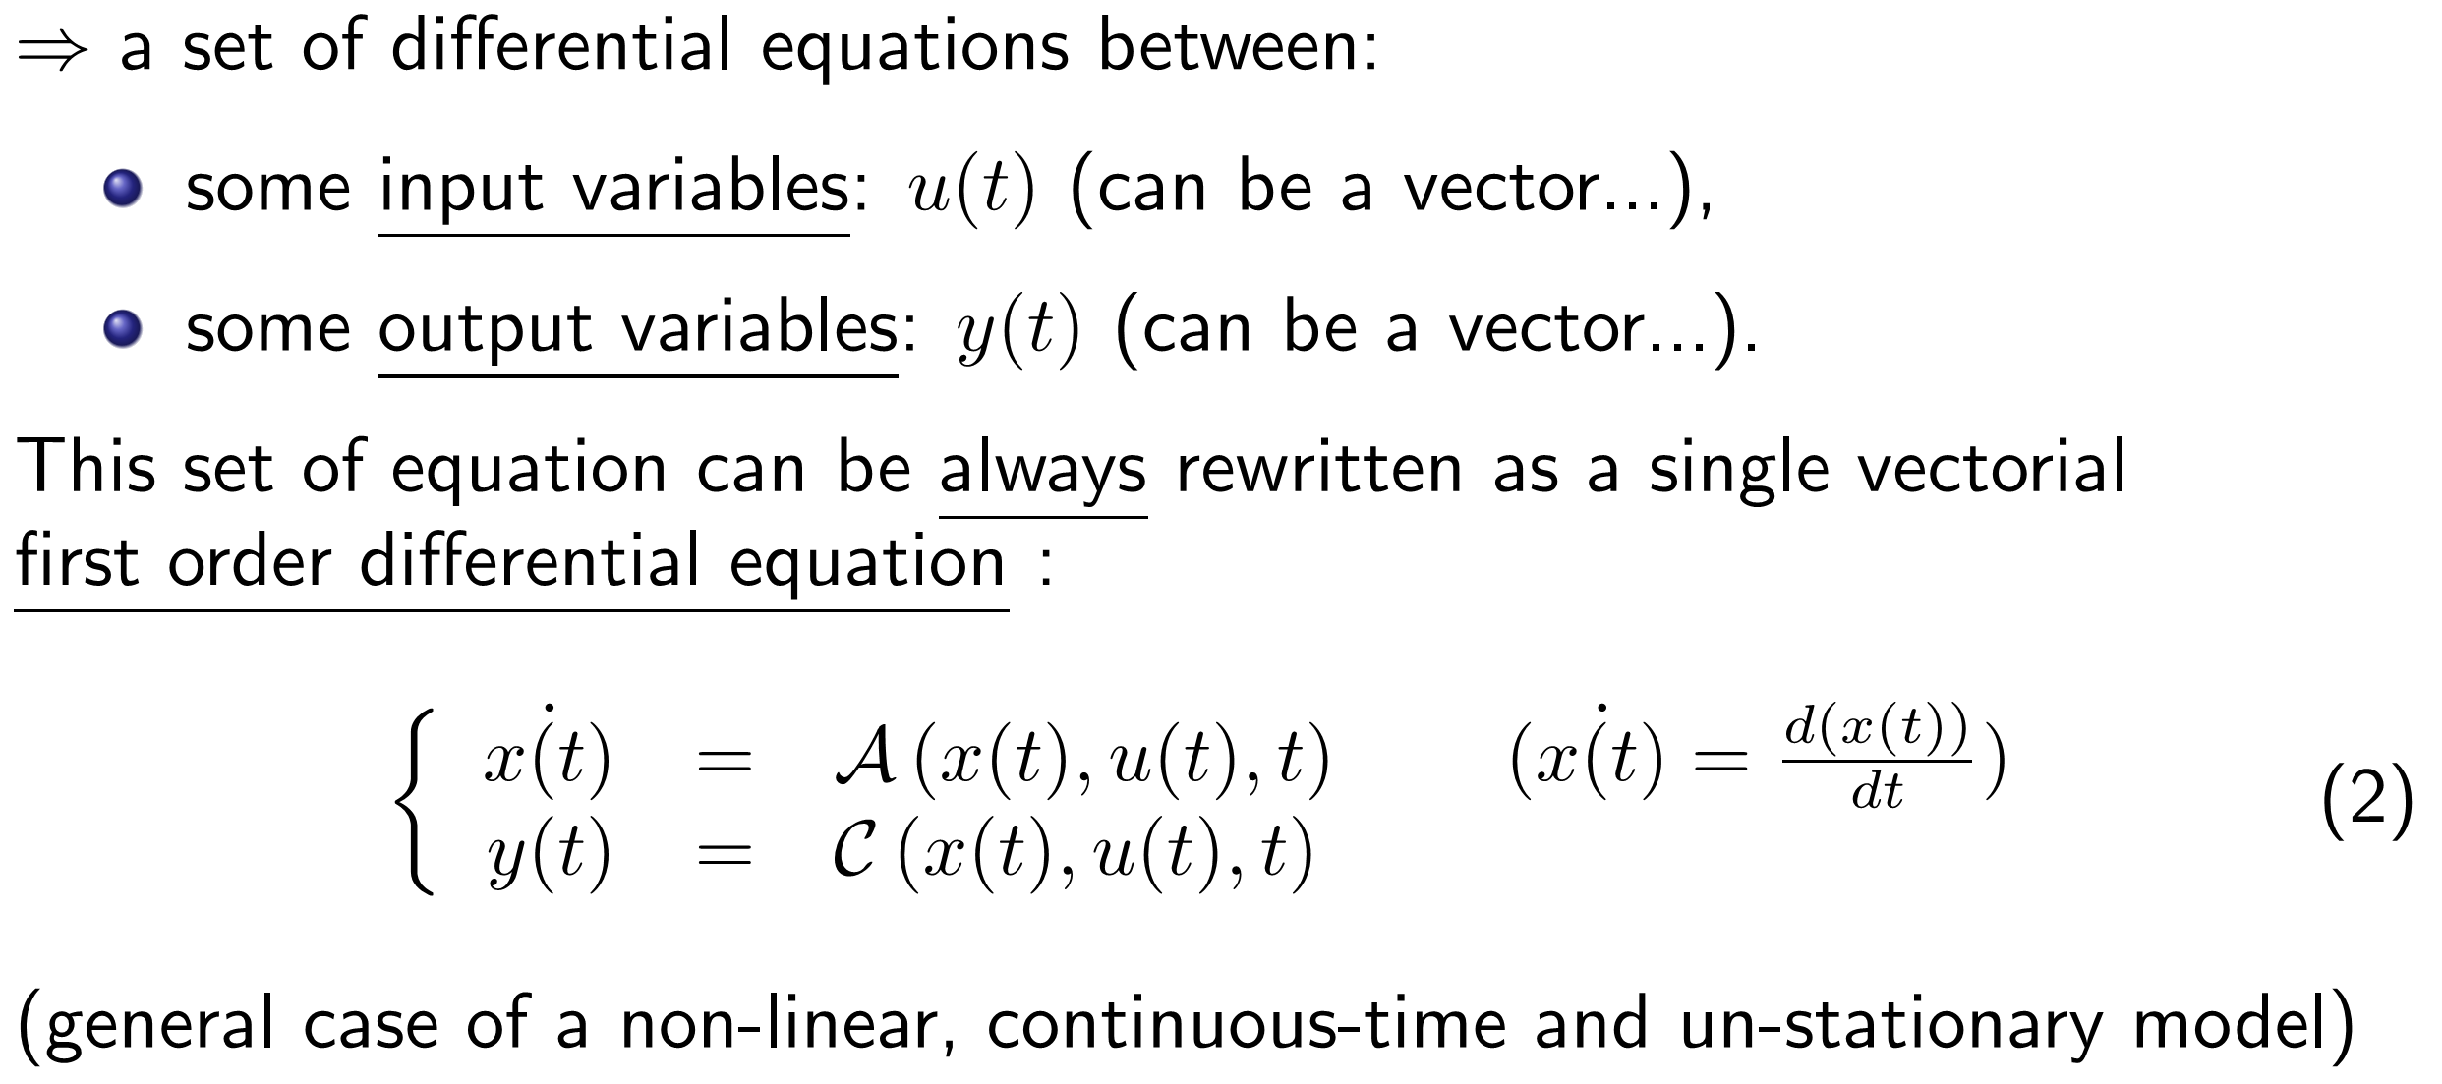
Knowledge-based models
Applying general principles (Newton dynamic principles, electrical basic rules, aerodynamics, magnetics, thermodynamics, ...):

Slide 18
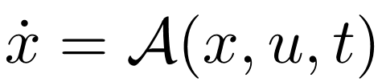
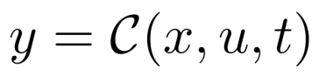
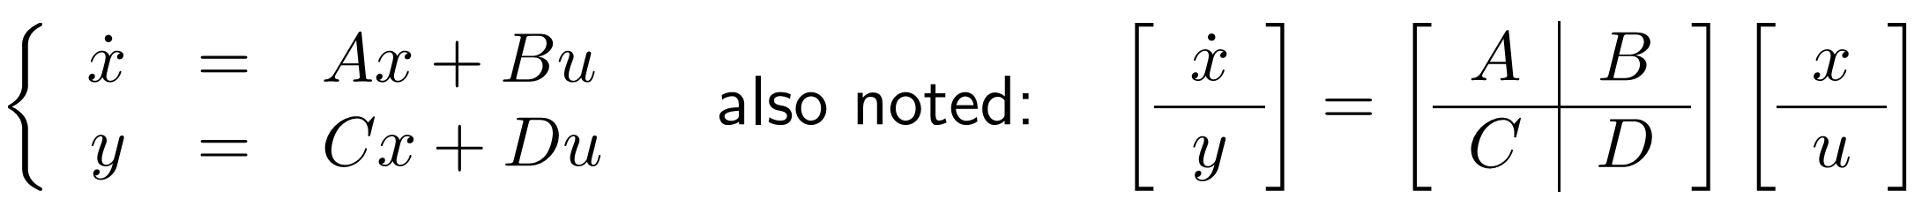
State-space representation
x(t) is the state vector: that is the set of all independence variables such that the knowledge of these variables and the input function u(t) will allow the future state and output of the system to be determined (using state space model (2)).
is the state equation which describes the whole system dynamics.
is the output equation which describes the relation between the output y(t) and the state vector alone with the input.
A state-space model consists of a state equation and a output equation.
In the case of a linear and stationary system, the state space model can be expressed as :
(3)

Slide 19
State-space representation
Remark:
For a n−th order model (n is the number of state variables in x) with m inputs and p outputs:
A (dynamic matrix) is a n × n matrix,
B (input matrix) is n × m,
C (output matrix) is p × n,
D (direct feed-through matrix) is p × m.
Notes:
N个独立的储能元件。两个电容并联算一个大电容，两个电感串联算一个大电感。弹簧。

Slide 20
State-space modeling: examples and exercises
Example: A state-space representation of the following RLC network:
Exercise: find a state-space representation between the input force f and the output position y1, y2:

Slide 21
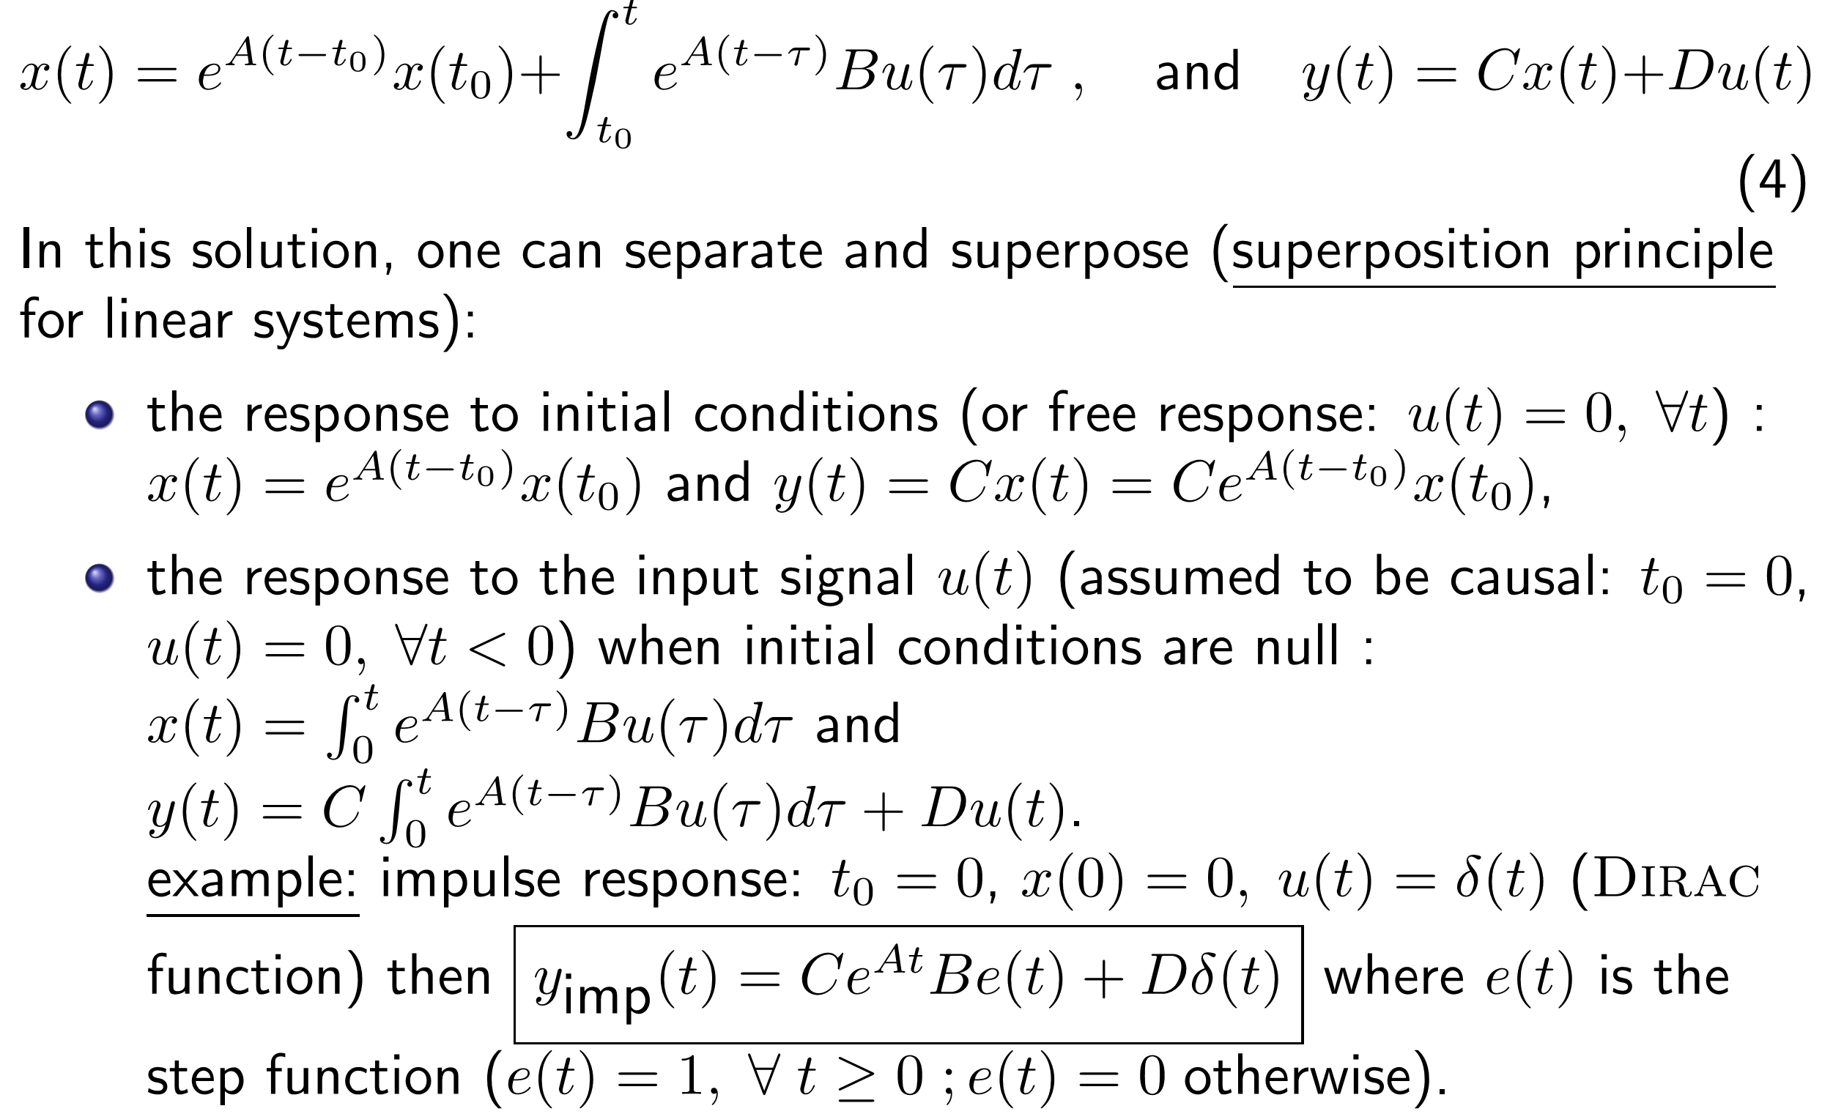
State-space equation integration
The general solution of the linear state space equation (3) reads:

Slide 22
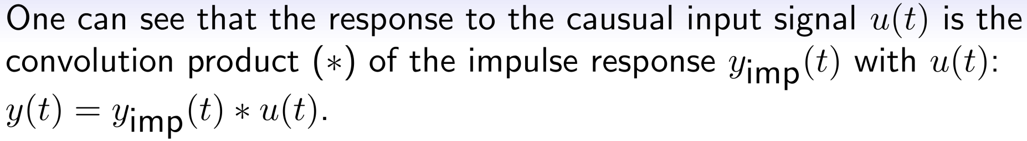
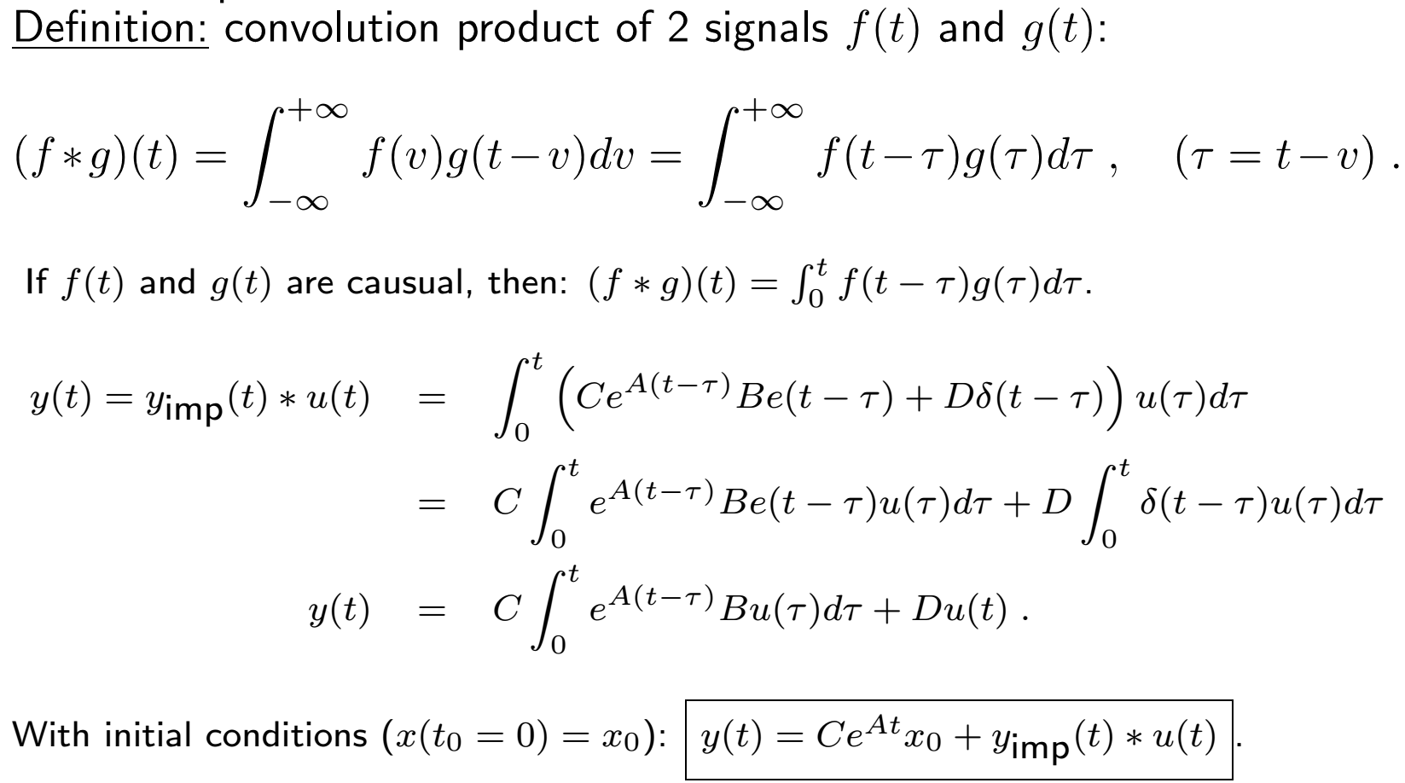
State-space equation integration

Slide 23
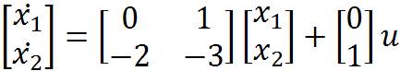
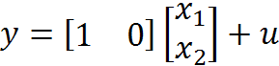
State-space equation integration: exercises
Exercise: Compute the system impulse response:

Slide 24
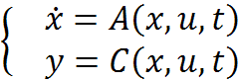

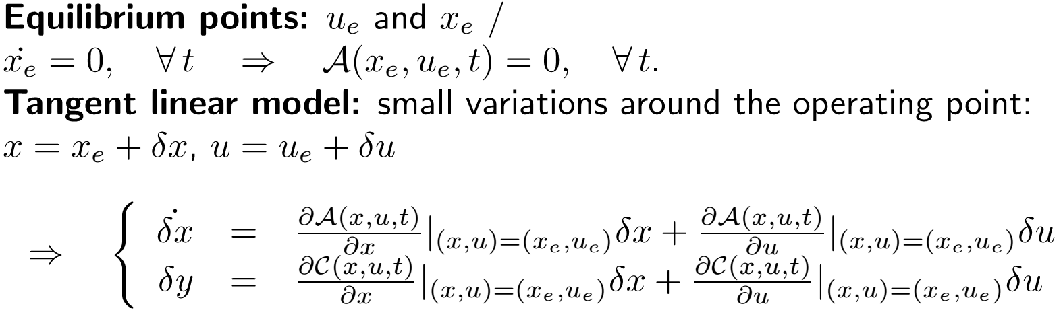
Equilibrium point linearization
In the case of a non-linear system:
a practical approach consists in computing the tangent linear model around an equilibrium (or operating) point.

Slide 25
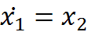
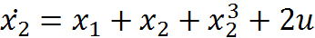
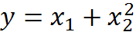
Equilibrium point linearization: exercises
Exercise: compute the tangent linear model of the following non-linear system around the equilibrium point x0=0:

Slide 26
Outline
Introduction
Modeling and mathematical representations of models
State-space representation
Transfer function representation
Functional block-diagram representation
Conversion state-space ⇔ transfer function
Experimental model
Linear system analysis
Discrete-time linear systems
Controllability and observability

Slide 27
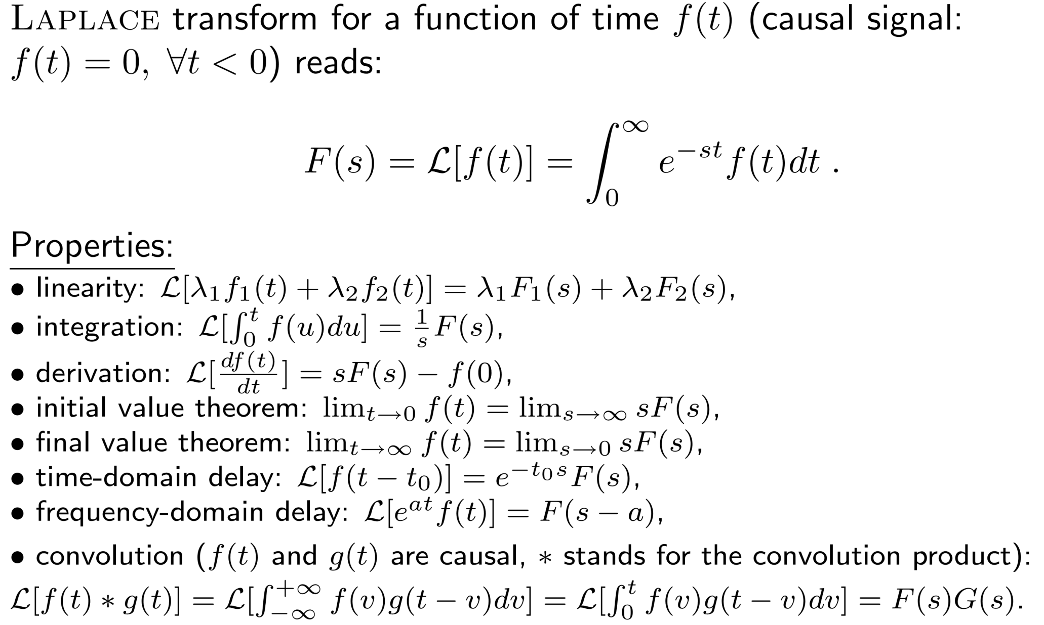
Laplace transform

Slide 28
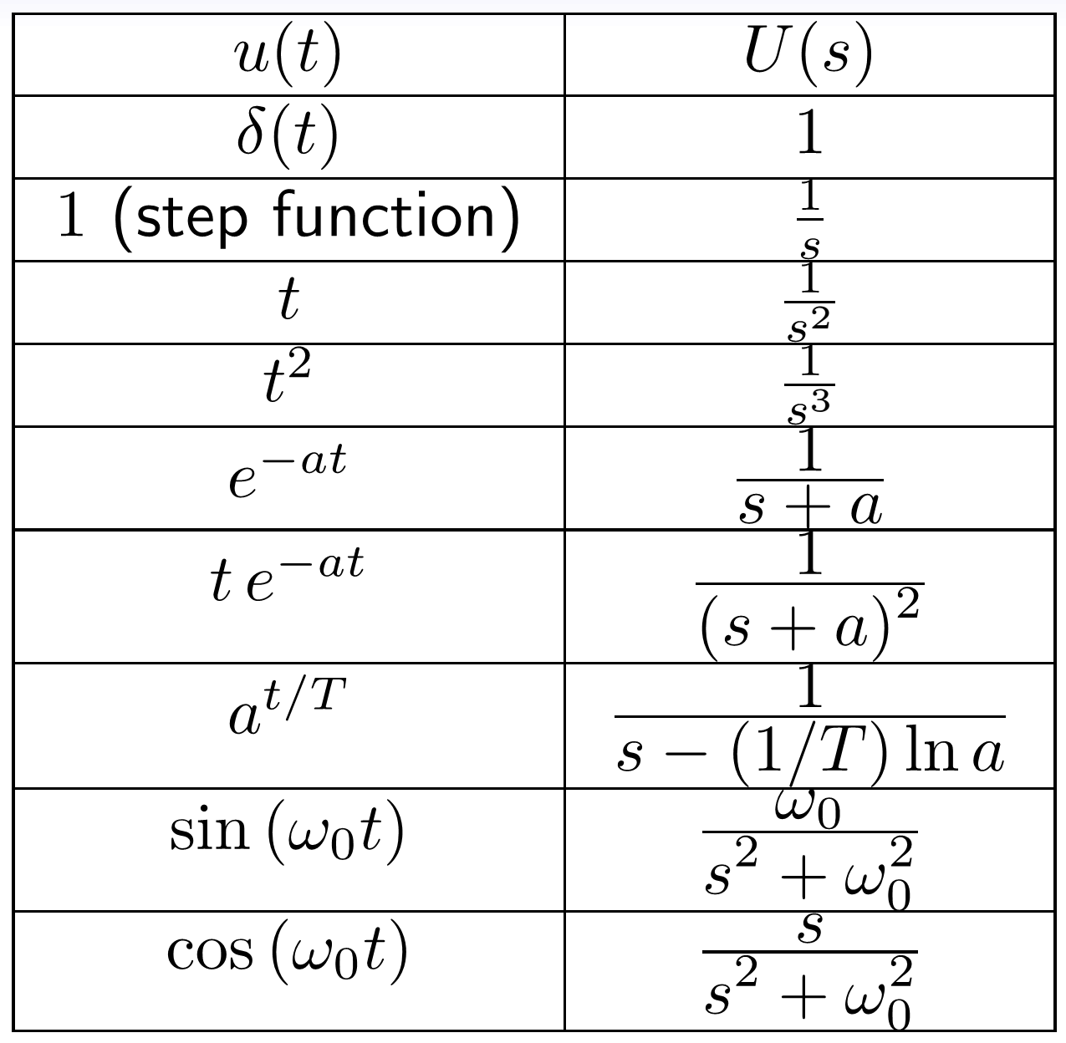
Usual Laplace transform pairs
1/2
Laplace transforms a (complex) differential equation into a (simple) algebraic equation.

Slide 29
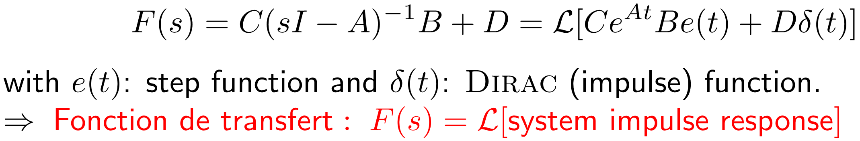
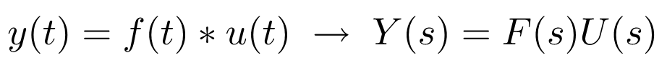
Transfer function for a SISO system
The Transfer Function is the ratio of the Laplace transform of the output signal to the Laplace transform of the input signal.
Consider the n-th order differential equation between input u and output y:
Apply Laplace transformation to it (initial conditions=0)
If we apply the Laplace transform to the state space model (3), we get:
The Transfer Function:

Slide 30
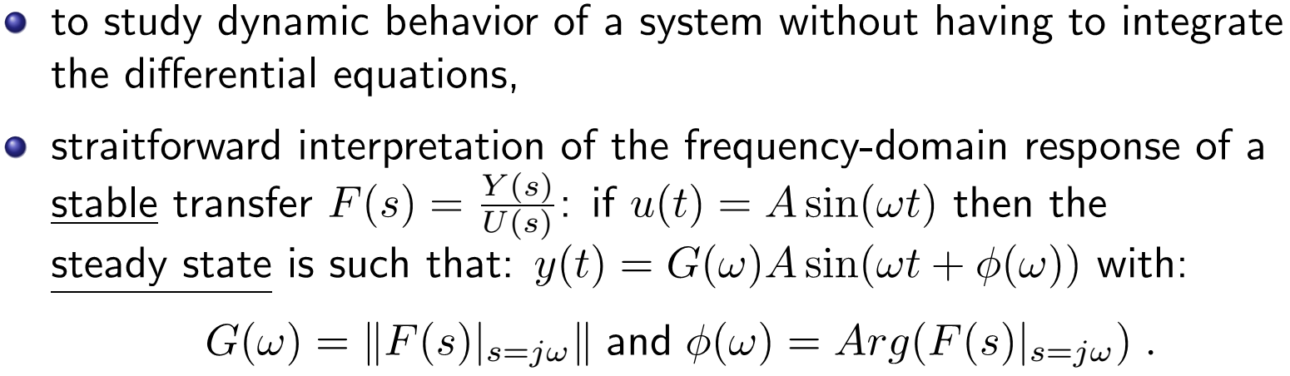
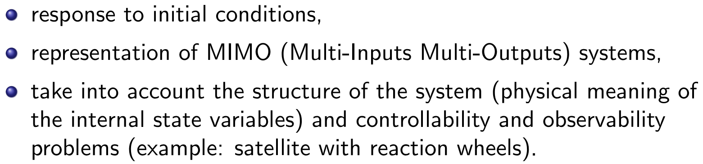
Transfer function vs state space model
Transfer function:
State space model:
straight forward interpretation of the frequency-domain response of a

Slide 31
Outline
Introduction
Modeling and mathematical representations of models
State-space representation
Transfer function representation
Functional block-diagram representation
Conversion state-space ⇔ transfer function
Experimental model
Linear system analysis
Discrete-time linear systems
Controllability and observability

Slide 32
Block-diagram representation
Due to powerful software tools like MATLAB/SIMULINK, more and more models are now described by a functional block-diagram which represent the transfer function. A well-posed functional block-diagram involves only integrators (in minimal number), sums and gains with a direct link to physical parameters.
To simulate non-linear systems, the block-diagram may also involved some non-linear functions (saturation, trigonometric functions,...).
Example: draw a functional block-diagram to represent:
the non-linear equation of the pendulum:
the general state-space equation:

Slide 33
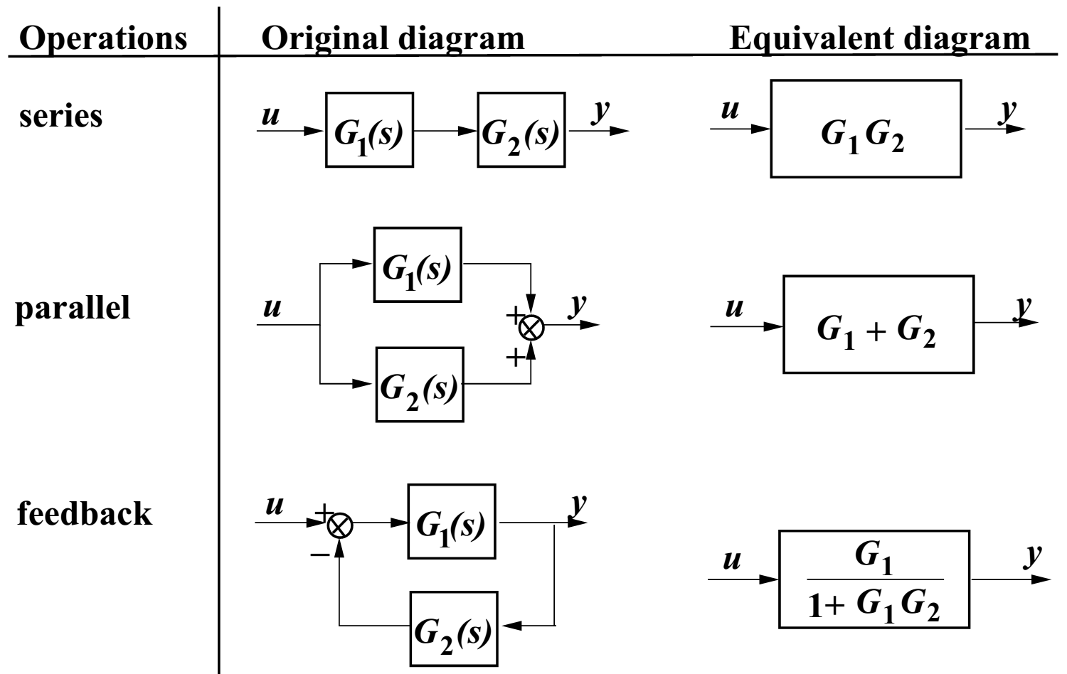
Block-diagram equivalent conversion

Slide 34
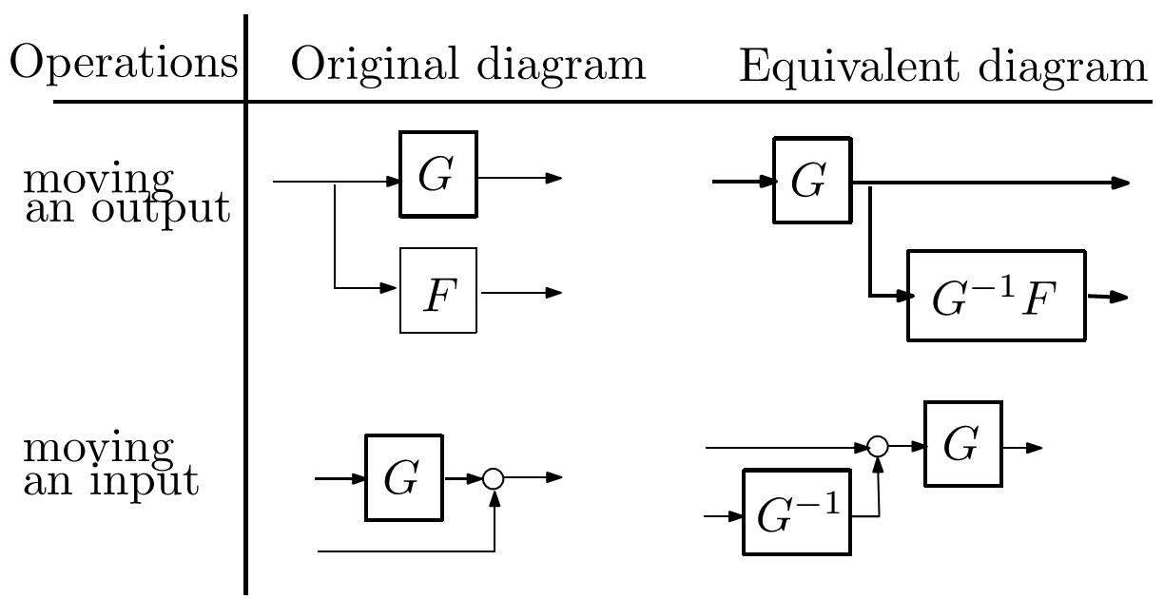
Block-diagram equivalent conversion
WARNING: Original and equivalent diagrams are equivalent from the input-output transfer point of view NOT FROM the state-space representation point of view!!

Slide 35
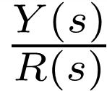
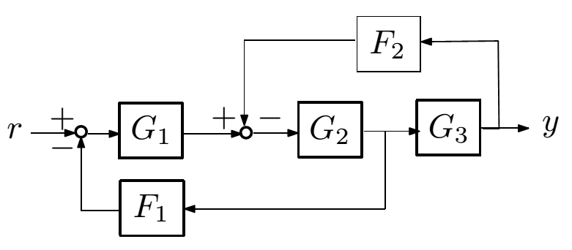
Block-diagram representation: exercises
Exercise : Considering the following block-diagram, compute the transfer function :
let (Ai, Bi, Ci, Di) be the state space model of Gi(s), associated with state vector xi. Express the state space model between u and y for the 3 equivalent diagrams of series, parallel and feedback connections.

Slide 36
Outline
Introduction
Modeling and mathematical representations of models
State-space representation
Transfer function representation
Functional block-diagram representation
Conversion state-space ⇔ transfer function
Experimental model
Linear system analysis
Discrete-time linear systems
Controllability and observability

Slide 37
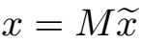
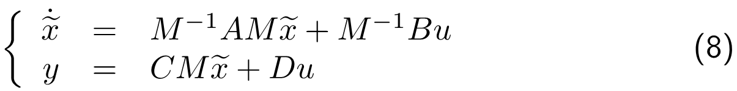
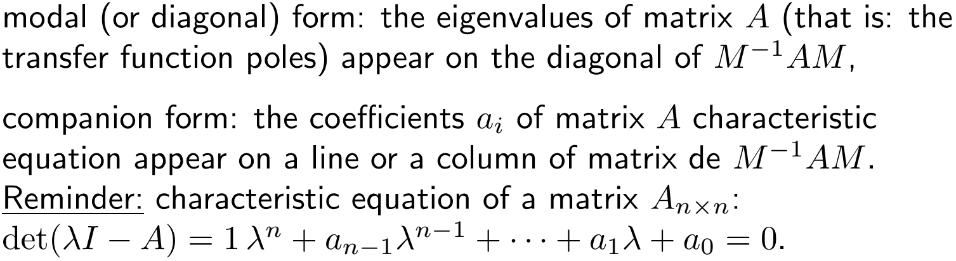
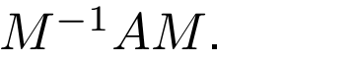
Non uniqueness of state space representation
An infinity of quadruplets (A, B, C, D) exist to represent an input → output transfer. Indeed, let us consider the change of variable
(with M invertible) in equation (3), then we get a new state space representation:
Canonical forms:

Slide 38
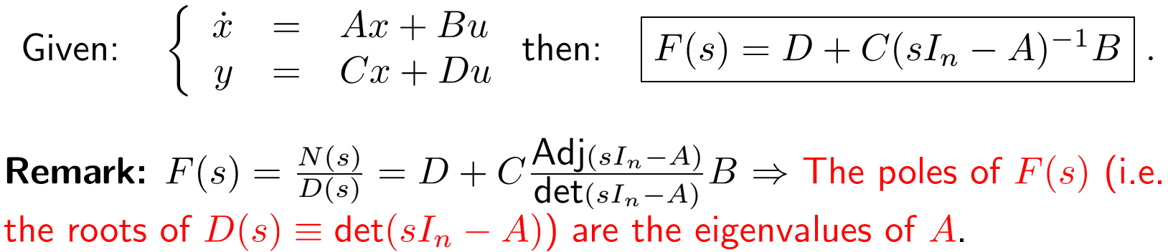
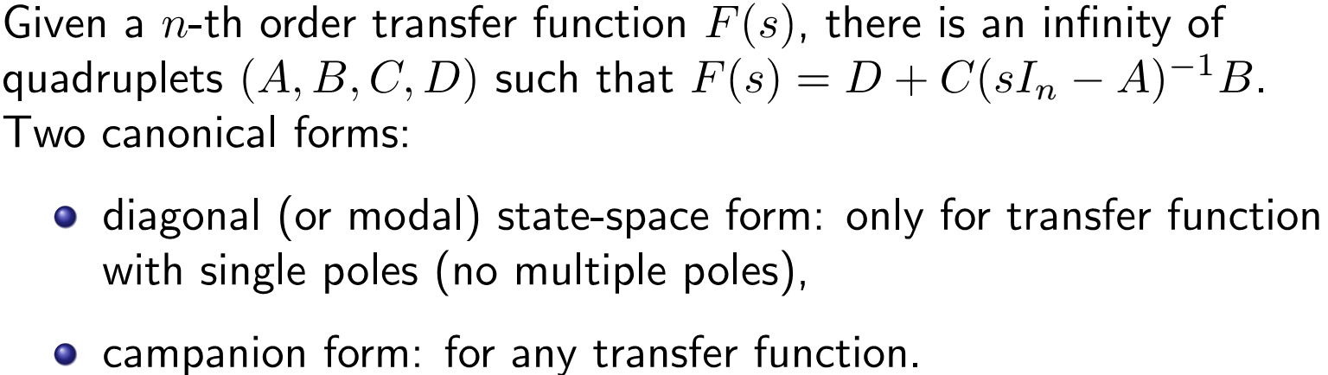
Conversion: state-space ⇔ transfer function
State-space to transfer function conversion: (help ss2tf)
Transfer function to state space conversion: (help tf2ss)

Slide 39
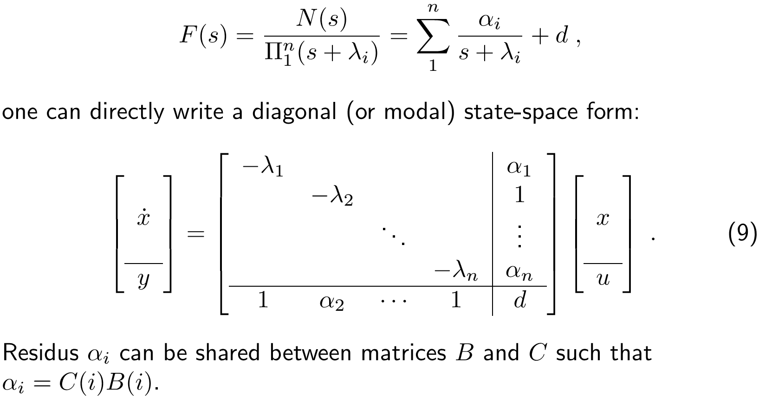
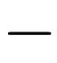
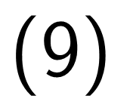
Diagonal state-space form (SISO)
Assumptions: no multiple pole in the transfer function. From a partial fraction expansion of F(s):

Slide 40
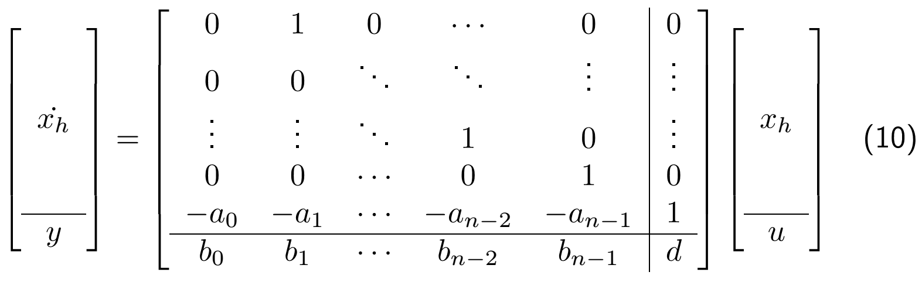
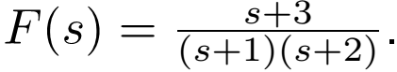
Companion state-space form (SISO)
Any proper n-th order transfer function can be written:
Then, an horizontal companion state-space form reads:
Exercise: give 2 different state space representations for the system defined by the transfer function:

Slide 41
Outline
Introduction
Modeling and mathematical representations of models
State-space representation
Transfer function representation
Functional block-diagram representation
Conversion state-space ⇔ transfer function
Experimental model
Linear system analysis
Discrete-time linear systems
Controllability and observability

Slide 42
Experimental model
Another way to build a model of the system:
system identification, a more common approach is therefore to start from measurements of the behavior of the system and the external influences (inputs to the system) and try to determine a mathematical relation between them without going into the details of what is actually happening inside the system.
the system is excited by a signal with a wide frequency response u(t) (white noise) or by a harmonic signal with a frequency scan.
computation of the frequency response of the system (point by point) using spectral analysis ⇒ non-parametric model.
identification ⇒ computation of a parametric model (such as transfer function) fitting the experimental response.

Slide 43
Outline
Introduction
Modeling and mathematical representations of models
Linear system analysis
Modal analysis - stability analysis
Time-domain analysis
Frequency-domain analysis
Discrete-time linear systems
Controllability and observability

Slide 44
Outline
Introduction
Modeling and mathematical representations of models
Linear system analysis
Modal analysis - stability analysis
Time-domain analysis
Frequency-domain analysis
Discrete-time linear systems
Controllability and observability

Slide 45
An introductive example
Stable (1→2)
Asymptotically Stable (1→4)
Instable (1→5)

Slide 46
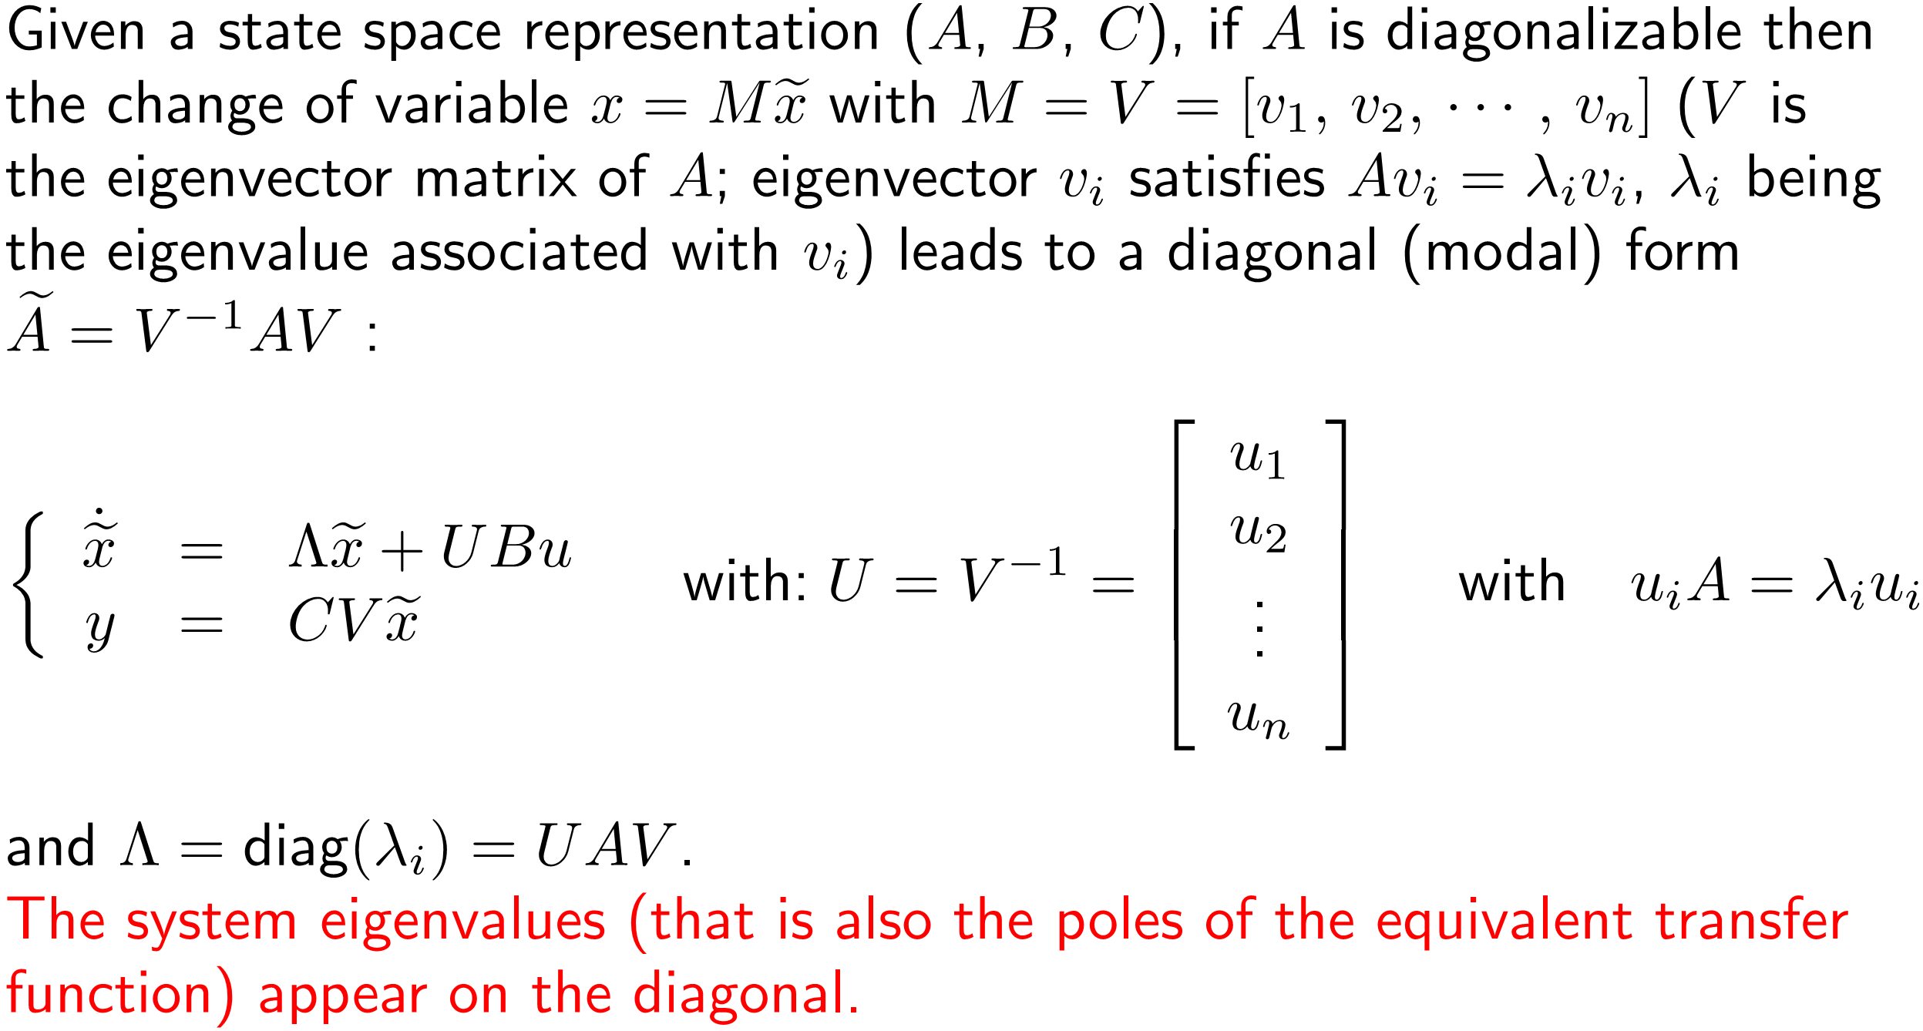
Diagonal (Modal) Form

Slide 47
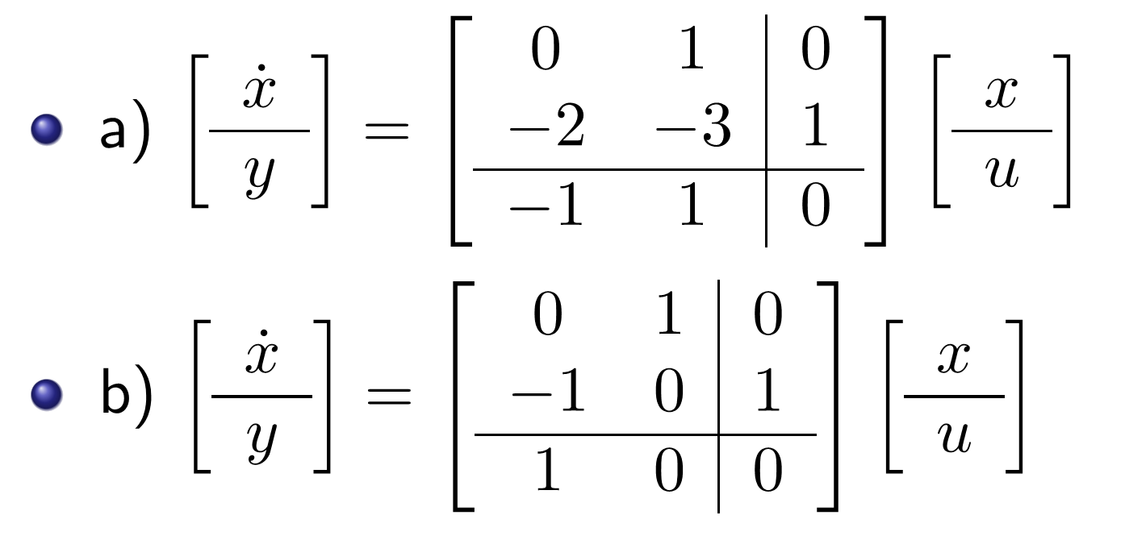
Exercise: Modal Form
Exercise: compute modal forms for following systems:

Slide 48
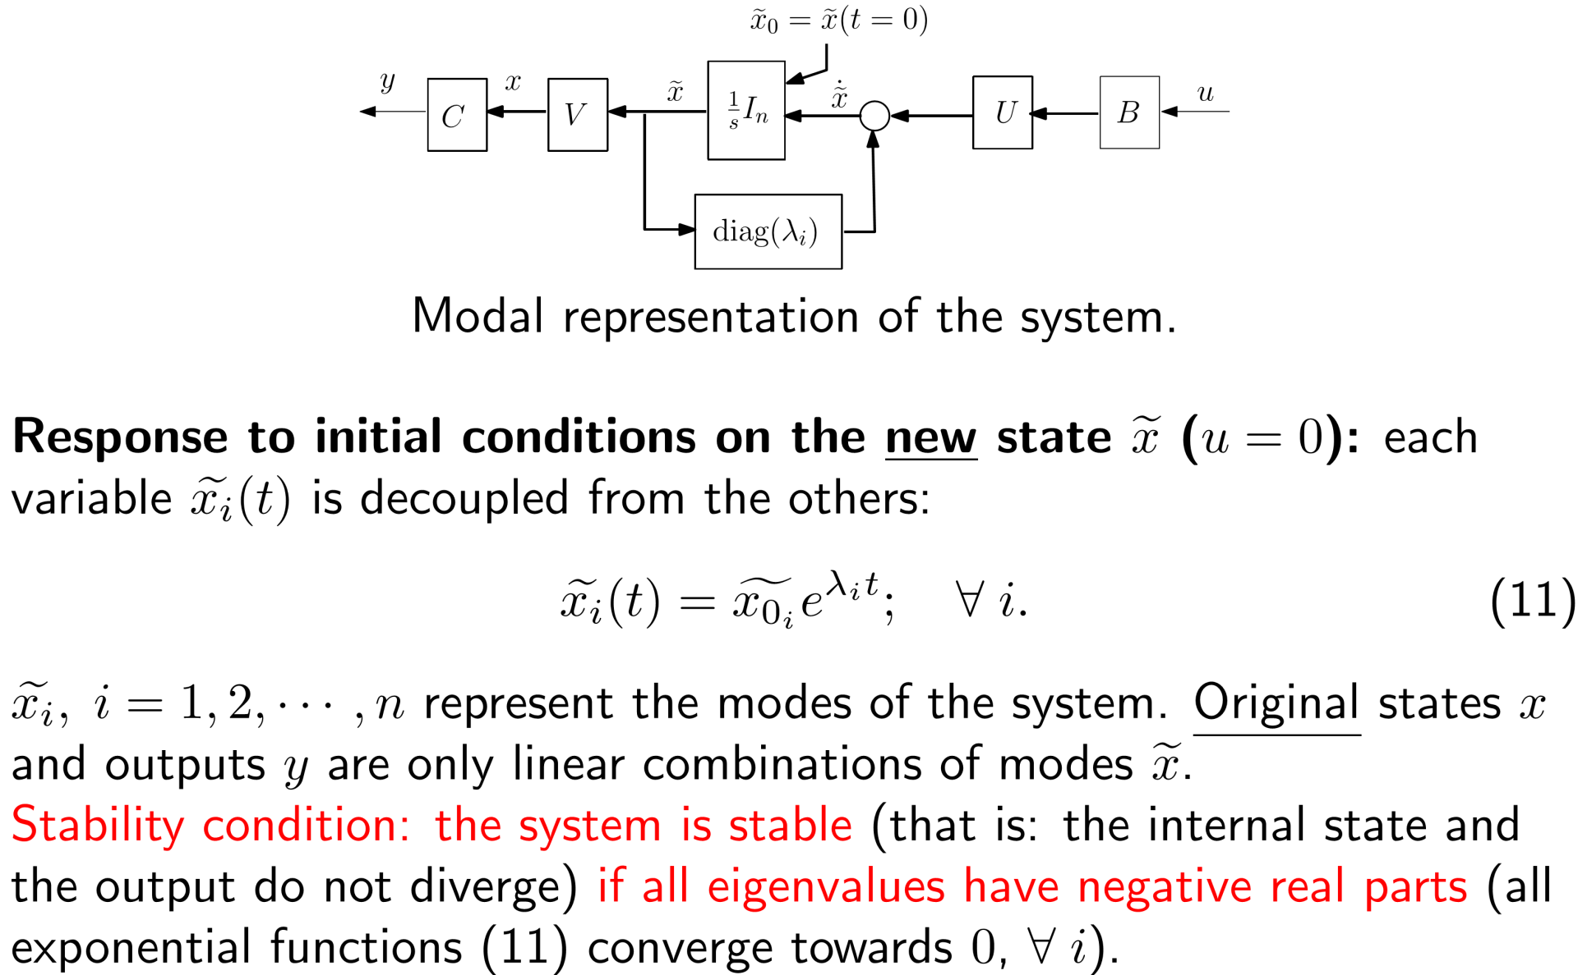
Stability Analysis
The system can be described by the following block-diagram :

Slide 49
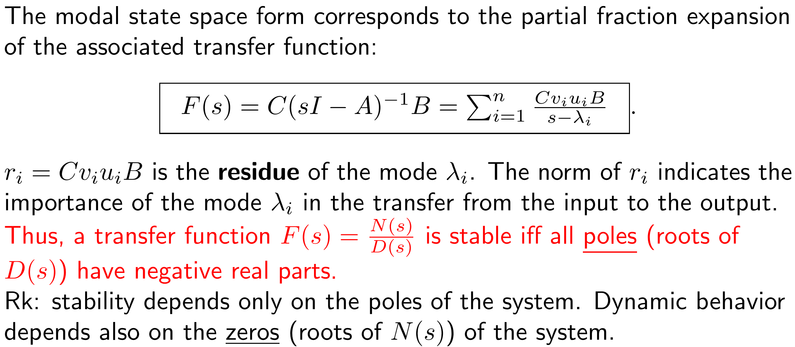
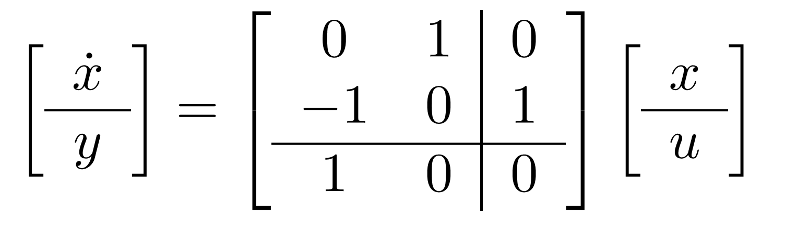
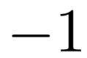


Stability Analysis
Exercise: analysis the stability of the system:

Slide 50
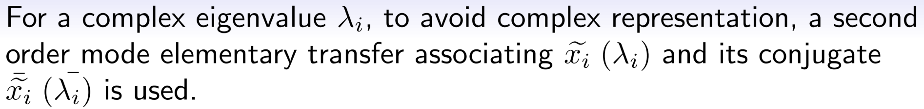

Stability Analysis

Slide 51


Stability Analysis
In the multiple eigenvalue case, A is not necessarily diagonalizable, one can use bloc-diagonal matrices involving Jordan-blocs.
Exercise:
Compute Jordan canonical forms for following system:

Slide 52

Stability Analysis
Formulae (12) allows any systems to be interpreted as a combination of elementary first order and second order transfers. These elementary transfers allows to appreciate roughly the dynamics behavior of the system.

Slide 53
Outline
Introduction
Modeling and mathematical representations of models
Linear system analysis
Modal analysis - stability analysis
Time-domain analysis
Frequency-domain analysis
Discrete-time linear systems
Controllability and observability

Slide 54

Time-domain Analysis
Some typical test input signal:

Slide 55
Time-domain Analysis
Transient response
Steady state response
Performance criteria (commonly measured on a step response):
Delay time td (0%-50% )
Rise time tr
Peak time tp
Settling time ts (± 5%)
Overshoot σ%
Steady state (or static) error ess
Rise time is defined as "the time required for the response to rise from x% to y% of its final value", with 0%-100% rise time common for under-
-damped second order systems, 5%-95% for critically damped and 10%-90% for overdamped.

Slide 56
Performance Criteria

Slide 57

Step responses for first order system

Slide 58
Step responses for first order system

Slide 59

Step responses for second order system

Slide 60

Step responses for second order system

Slide 61







Performance Criteria of second order system
Delay time
Peak time
Settling time(± 5%, ± 2%)
Exercise:
Compute K,τ,td,tr,ts
σ%=20%
Tp=1s
Rise time
Overshoot σ%

Slide 62

Step responses for second order system with zeros

Slide 63
Outline
Introduction
Modeling and mathematical representations of models
Linear system analysis
Modal analysis - stability analysis
Time-domain analysis
Frequency-domain analysis
Discrete-time linear systems
Controllability and observability

Slide 64


Frequency-domain analysis
Response to an harmonic signal whose pulsation is scanned from 0 to ∞:

Slide 65

BODE plots for a first order system

Slide 66

BODE plots for a second order system
Exercise:

Slide 68
NYQUIST plots

Slide 69
Cauchy's argument principle
From complex analysis, we know that a contour Γs drawn in the complex [s] plane, encompassing but not passing through any number of zeros and poles of a function F(s), can be mapped to another plane (the [F(s)] plane) by the function F(s).
The Nyquist plot of F(s), which is the contour Γ F(s) = F (Γs ) will encircle the origin point of the F(s) plane N times, where N = P-Z. Here are P and Z respectively the number of poles and zeros of F(s) inside the contour Γs .
Example:
Z=1, P=3, N=2, ∠F(S1)=4π Γ F(s) → counterclockwise
Z=1, P=0, N=-1, ∠F(S1)=-2π Γ F(s) → clockwise
N=0, Γ F(s) doesn’t encompass the origin point of the F(s) plane

Slide 70




Nyquist stability criterion
open loop transfer function:
closed loop transfer function:
auxiliary function:
Given a Nyquist contour Γs, let P be the number of poles of G(s)H(s) encircled by Γs, and Z be the number of zeros of 1+G(s)H(s) encircled by Γs. Alternatively, and more importantly, Z is the number of poles of the closed loop system in the right half plane. The resultant contour in the [G(s)H(s)] plane, Γ G(s)H(s) shall encircle (counterclockwise) the point (-1+j0) N times such that N = P-Z.

Slide 71
Outline
Introduction
Modeling and mathematical representations of models
Linear system analysis
Discrete-time linear systems
Discrete-time state space representation
Z-transform of discrete-time signal - Shannon theorem
Discrete-time transfer function
Stability Analysis of Discrete-time linear systems
Controllability and observability

Slide 72
Outline
Introduction
Modeling and mathematical representations of models
Linear system analysis
Discrete-time linear systems
Discrete-time state space representation
Z-transform of discrete-time signal - Shannon theorem
Discrete-time transfer function
Stability Analysis of Discrete-time linear systems
Controllability and observability

Slide 73

Discrete-time state space representation
Quite similar to the continuous-time case: dynamic modelling of a

Slide 74

Discrete-time state space equation integration
The general solution of the linear state space equation (13) reads:

Slide 75

Discrete-time state space equation integration
One can see that the response (15) to the causual input signal u(k) is

Slide 76
Outline
Introduction
Modeling and mathematical representations of models
Linear system analysis
Discrete-time linear systems
Discrete-time state space representation
Z-transform of discrete-time signal - Shannon theorem
Discrete-time transfer function
Stability Analysis of Discrete-time linear systems
Controllability and observability

Slide 77


Z-transform of discrete-time signal
Definition: the Z-transform H(z) of a discrete-time signal

Slide 78

Z-transform : properties

Slide 79

Z-transform : TABLE
1/2
1/2

Slide 80

Z-transform: Exercise
Exercise:

Slide 81

Shannon theorem & Aliasing phenomeon

Slide 82
Outline
Introduction
Modeling and mathematical representations of models
Linear system analysis
Discrete-time linear systems
Discrete-time state space representation
Z-transform of discrete-time signal - Shannon theorem
Discrete-time transfer function
Stability Analysis of Discrete-time linear systems
Controllability and observability

Slide 83

Discrete-time transfer function

Slide 84

System with Zero-order Holder

Slide 85

Conversion state-space ⇔ transfer function
All the block-diagrams operations and state-space ⇔ transfer function conversion presented in the coutinuous-time case are still valid for discrete-time systems changing:

Slide 86
Outline
Introduction
Modeling and mathematical representations of models
Linear system analysis
Discrete-time linear systems
Discrete-time state space representation
Z-transform of discrete-time signal - Shannon theorem
Discrete-time transfer function
Stability Analysis of Discrete-time linear systems
Controllability and observability

Slide 87


Stability Analysis of Discrete-time linear systems
A discrete-time system is stable iff all its poles (or eigenvalues) have a magnitude less than 1:

Slide 88


Stability Analysis of Discrete-time linear systems
Routh stability criterion
Bilinear transform
Exercise: Open-loop transfer function of a discrete-time system is defined:
If the related close-loop system is stable, compute the range of k.

Slide 89
Outline
Introduction
Modeling and mathematical representations of models
Linear system analysis
Discrete-time linear systems
Controllability and observability
Examples
Definitions and criterions

Slide 90
Outline
Introduction
Modeling and mathematical representations of models
Linear system analysis
Discrete-time linear systems
Controllability and observability
Examples
Definitions and criterions

Slide 91
Example 1
Input: u
Output: y=uc
State variables:
x1=iL
x2=uc
Initial conditions:
x(0)=0

Slide 92
Example 2
Input: u
Output: y=uc2
State variables:
x1=uc1
x2=uc2
Initial conditions:
x1(0)= x2(0)

Slide 93

Example 2
Let us consider the following interconnection structure between 3 sub-systems with initial conditions=0 :

Slide 94

Example 2

Slide 95

Example 2

Slide 96
Outline
Introduction
Modeling and mathematical representations of models
Linear system analysis
Discrete-time linear systems
Controllability and observability
Examples
Definitions and criterions

Slide 97

Definitions and criterions

Slide 98

Definitions and criterions

Slide 99



Exercise: observability
Exercise: consider the observability of following systems.
1.
2.

Slide 100

Exercise: controllability
Exercise: consider the controllability of the following system

Slide 101





Controllability form & Observability form
Controllability form:
Observability form :

Slide 102



Controllability form & Observability form
Exercise: Compute the controllability form and the observability form of the following system

Slide 103


Minimal realization

